Slide 1
AI & Crypto Currency
A price prediction of Ethereum Using Machine Learning and Deep Learning Methods

Slide 2
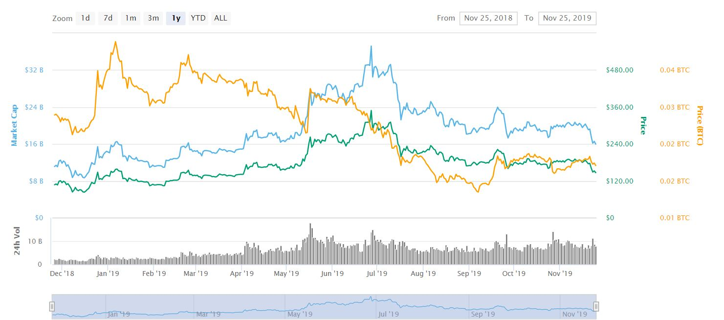

Why Ethereum?
A brief introduction of cypto currency

Slide 3
Data Mining
What I collected for training?

Slide 4

Transaction data
Price – Average, High, Low, Open price per day from 2017/1 to 2019/12
Vol. – The Trading Volume of the Day
Change – The price change according to yesterday in %
Comparison Data - Bitcoin

Slide 5
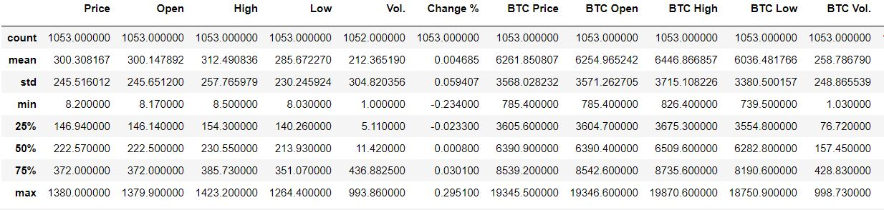
Quick view of Data

Slide 6
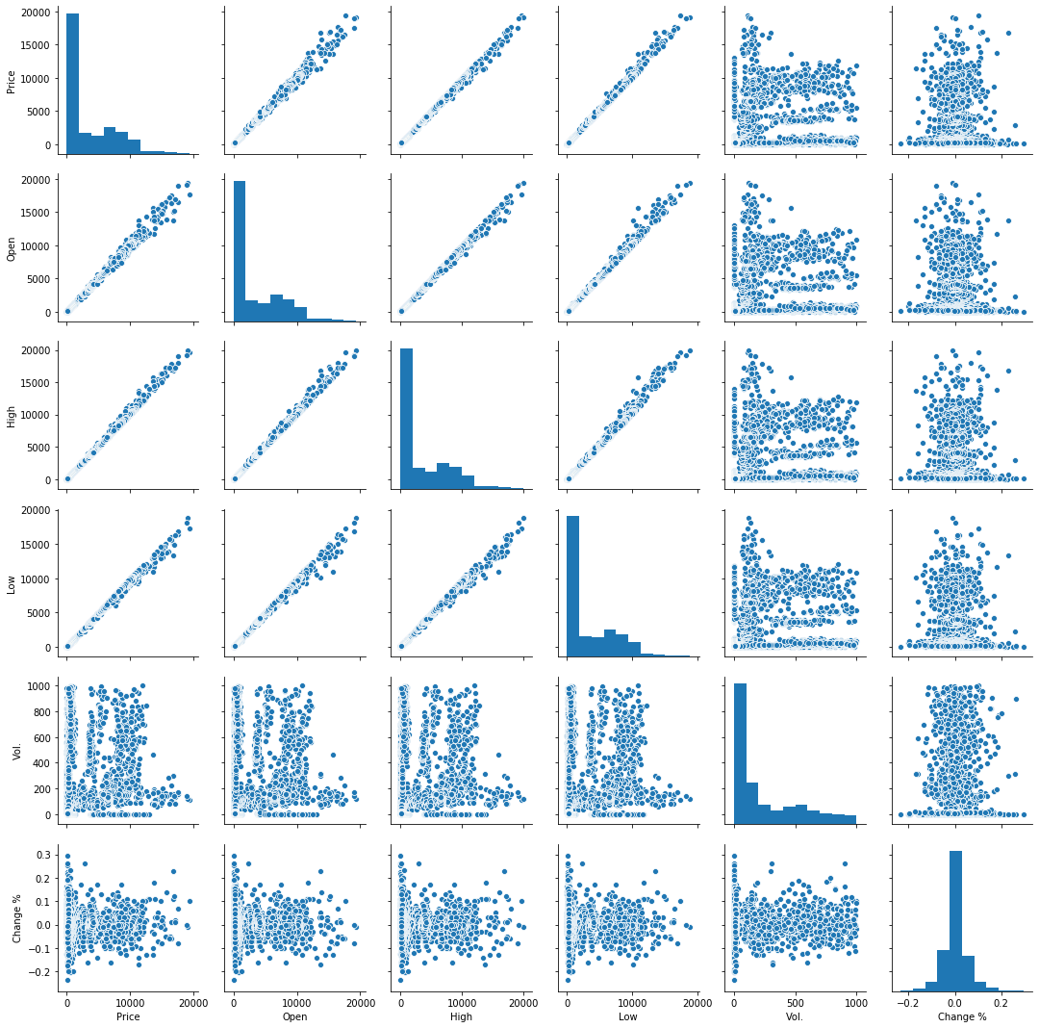
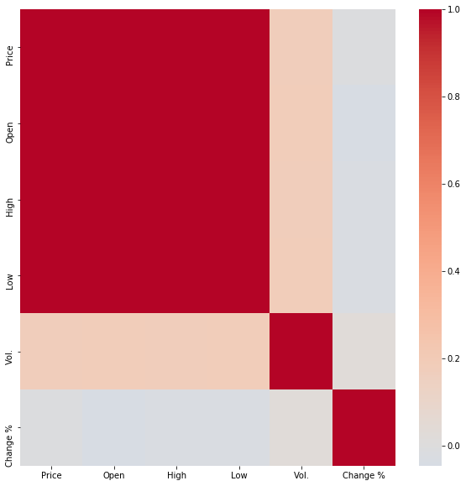
EDA Result

Slide 7
Price Prediction
Machine Learning - Regression

Slide 8

Price Prediction
Using logistic regression

Slide 9
Price Prediction
12/2
12/16
12/9
Final
Build DL model
Collect Recent Data
12/23
Using LSTM
As validation
Improve
Final Present
Adjust the model and check if there’s any other important data
Trade Bot
Try to integrate the result into

Slide 10
Improvements

Slide 11
Dataset
ETH price and BTC price
From 1/1/2017 to 12/31/2019

Slide 12

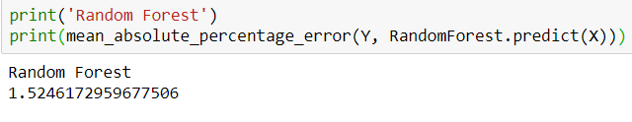
Two Other Ways
SVM
Random Forest

Slide 13
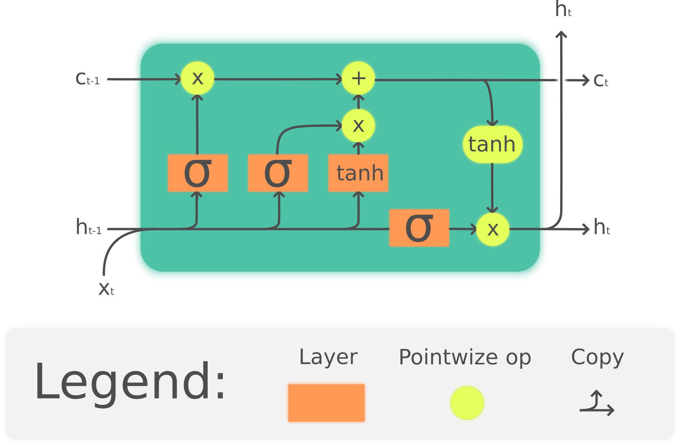
LSTM

Slide 14
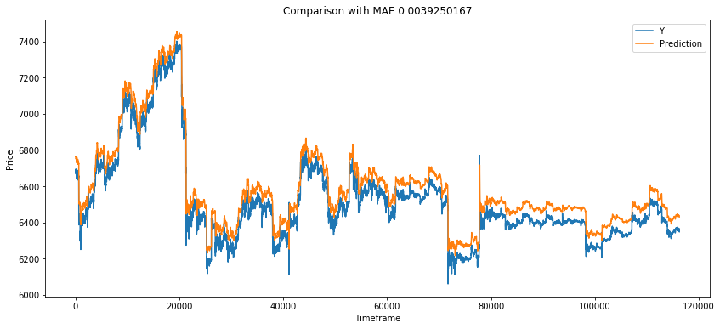
LSTM result
MAPE: 0.0039

Slide 15
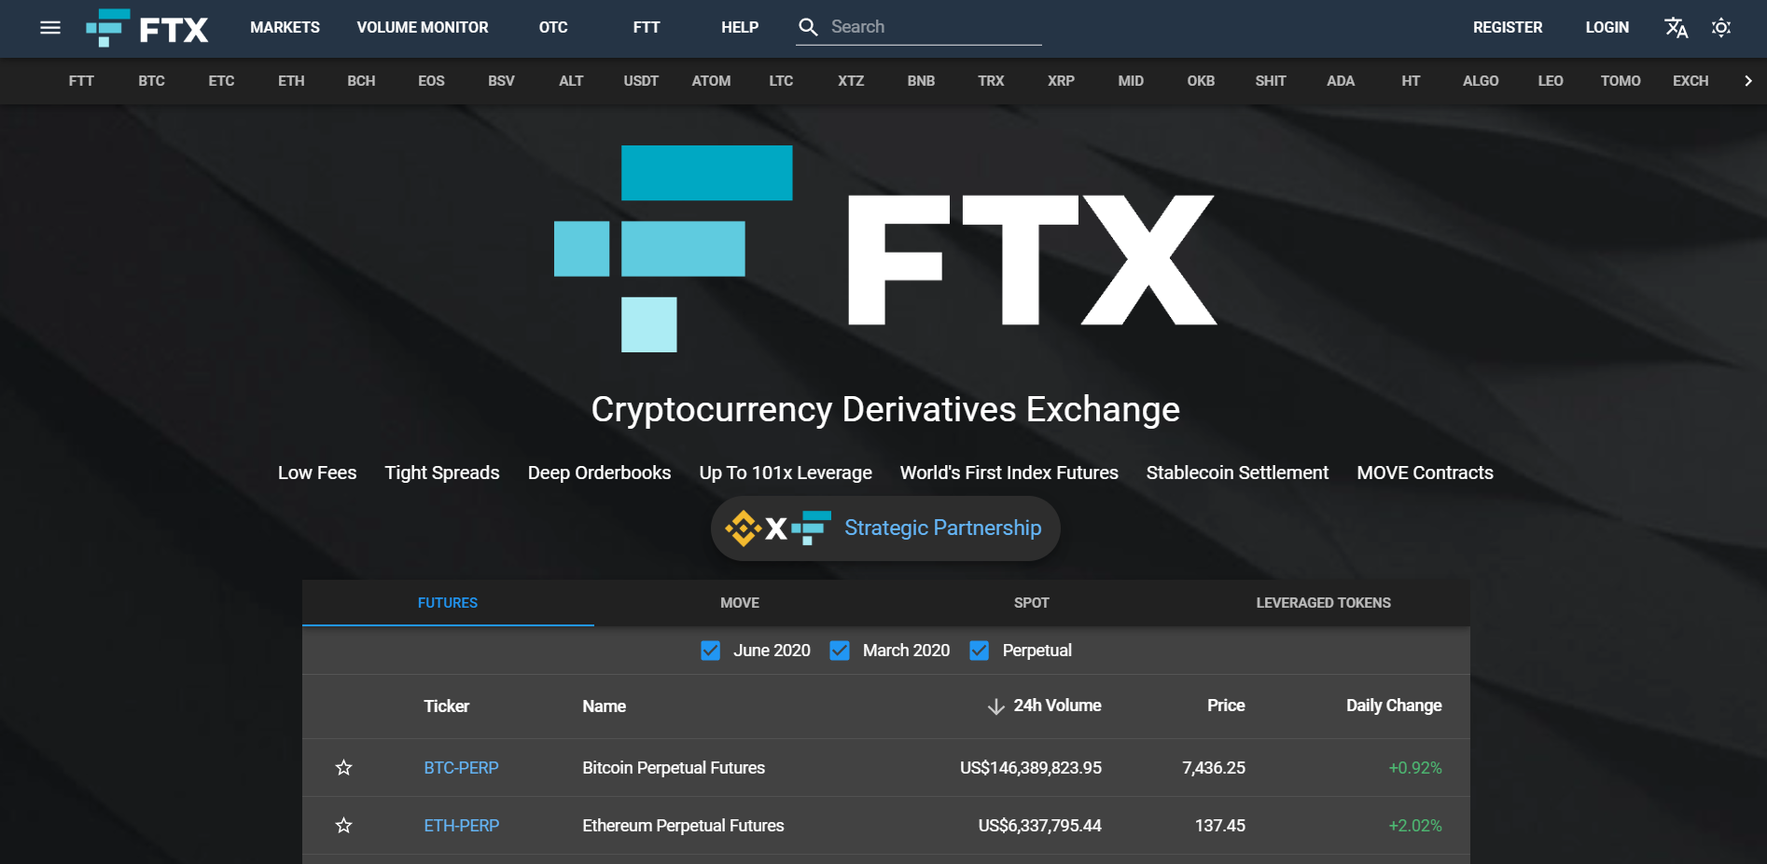
Trading Platform
FTX

Slide 16
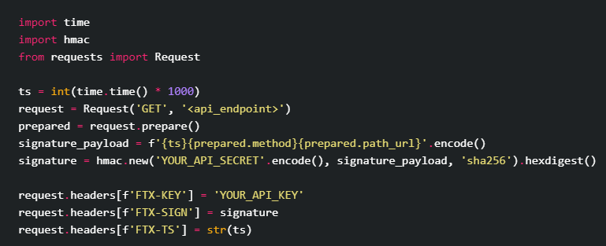
Trading API

Slide 17
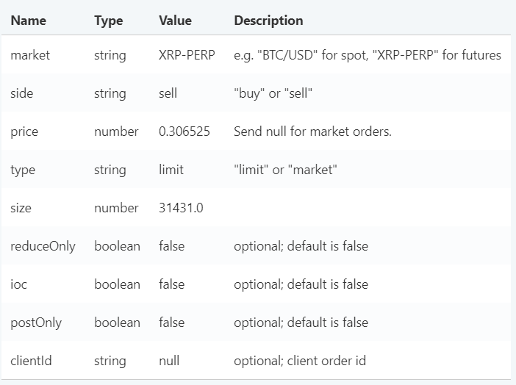
Place an Order

Slide 18

Deposit Founds

Slide 19
Easy Bot
The average predict of SVM and Random Forest
Testing time: 12/1 to 12/31
Initial Found: 40 usd
Outcome: 43.6 usd
Earnings: 9%

Slide 20
LSTM Eth Bot
Using the prediction of LSTM to do grid trading
Testing time: From now on
Initial Found: 50 usd
Expecting reward of 10% per week

Slide 21
Thanks for Listening
Q&A
By. Andrew Yang
Nov. 2019

